Slide 1


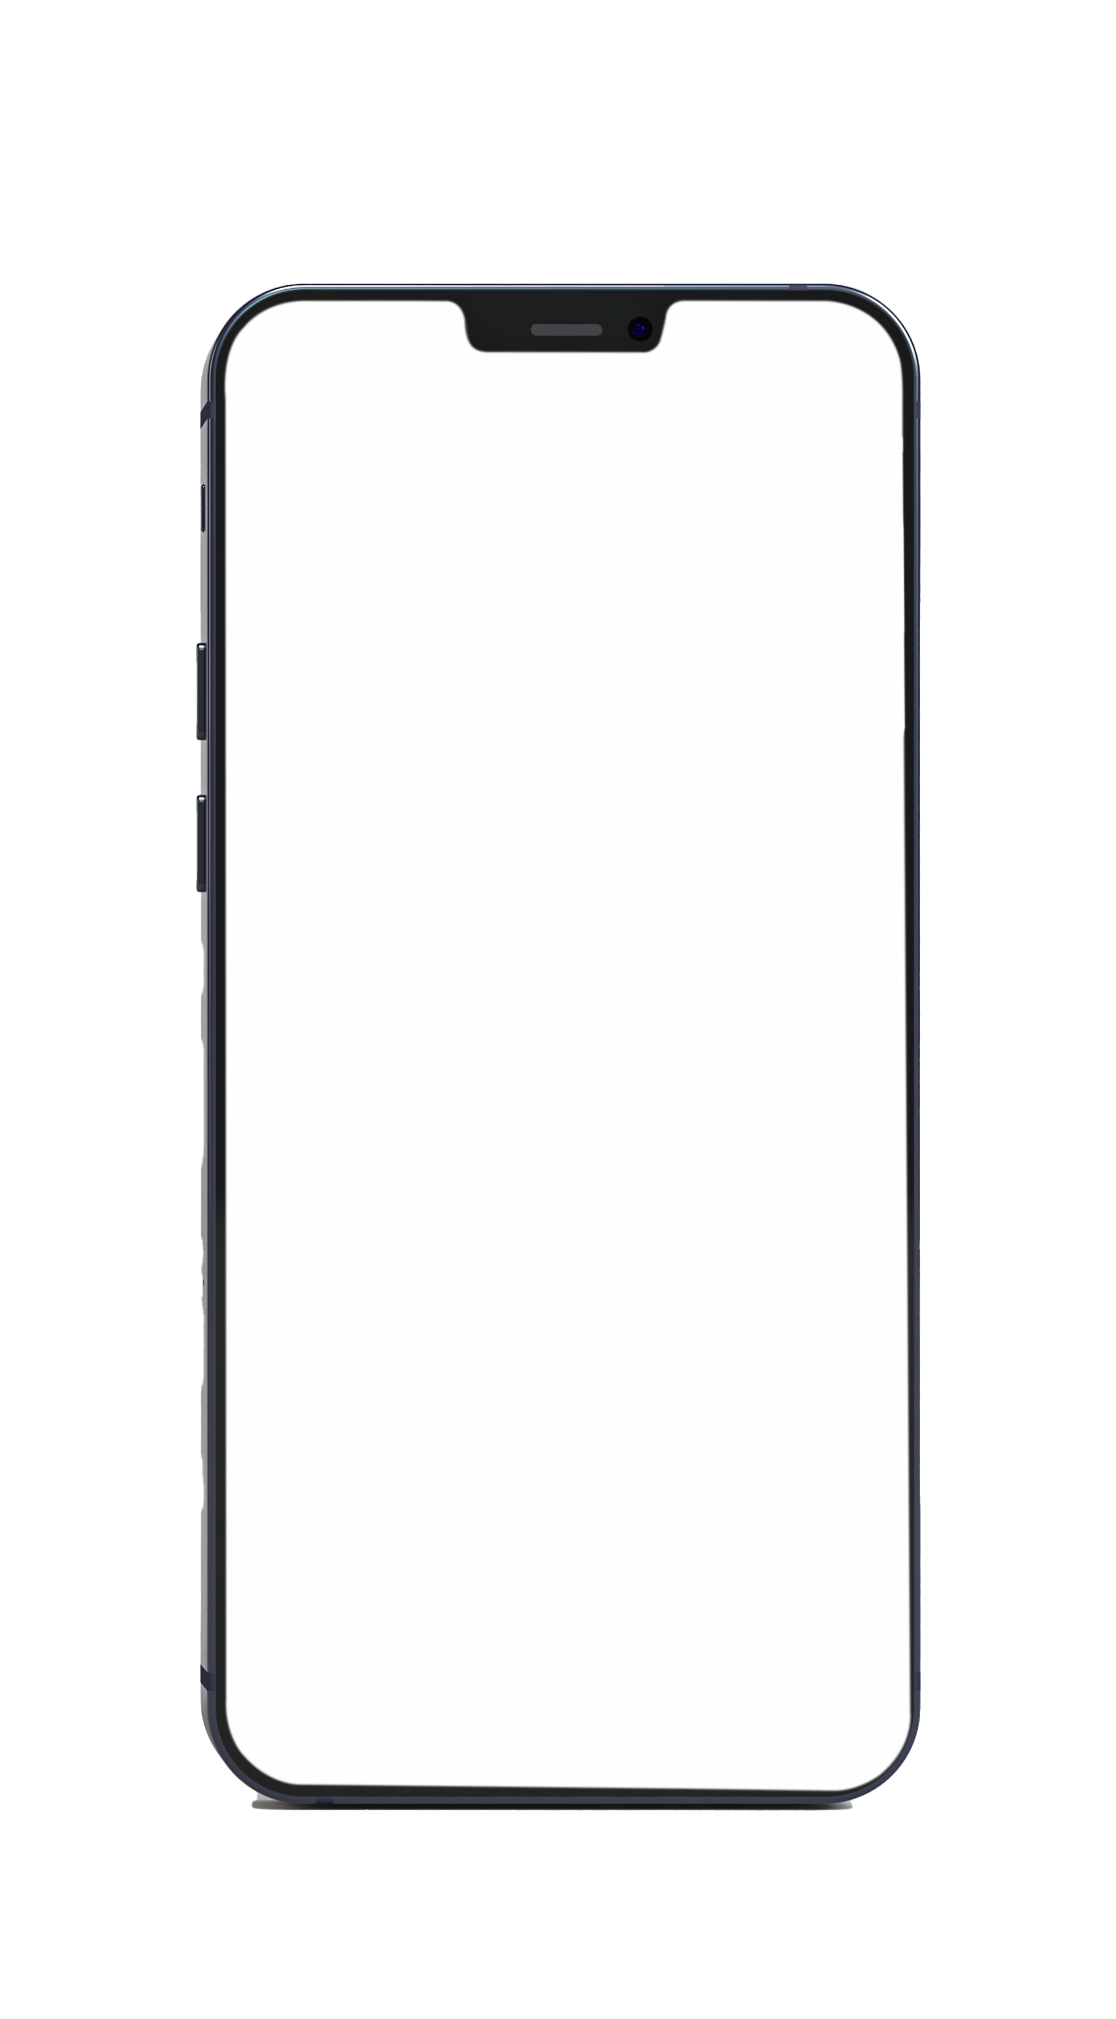


Finance Management System
By
Jinay Shah
12002080501027

Slide 2
What is Finance?
In India, there are various types of Finance methods that provide a Loan to the Require person and also there are many ways to get a loan from Bank or Person who Provide Money with Interest.
We is going to make the system for one Method of Finance in that the loan provider can divide the amount in 100 days of Slot after adding interest on the Amount. That collection Amount will deduct from that person.

Slide 3
Aim and Objective
For this Finance there are many clients and also, they have many accounts, so it is difficult to manage the process with the Number of Collector who collect the Collection.
The main Objective of this project is to ease the process of collection and monitoring process by Mobile application and Admin panel.
Software can be used by the collector and owner of the Business to make the process easy.

Slide 4
Needs of The System
01
02
03
04
05
Market Analysis of the Finance and Money.
Reduce the Cost of the Management.
Data Processing and Data Mining for Future Business Grow.
Transparency between Collector and Admin
Data of the Client.

Slide 5
Technology
Flutter Framework for Mobile Application
PHP for Backend REST Api
Hosting of GoDaddy
SQL – Database Management System
Data Mining using Python

Slide 6
Collector Mobile Application

Slide 7
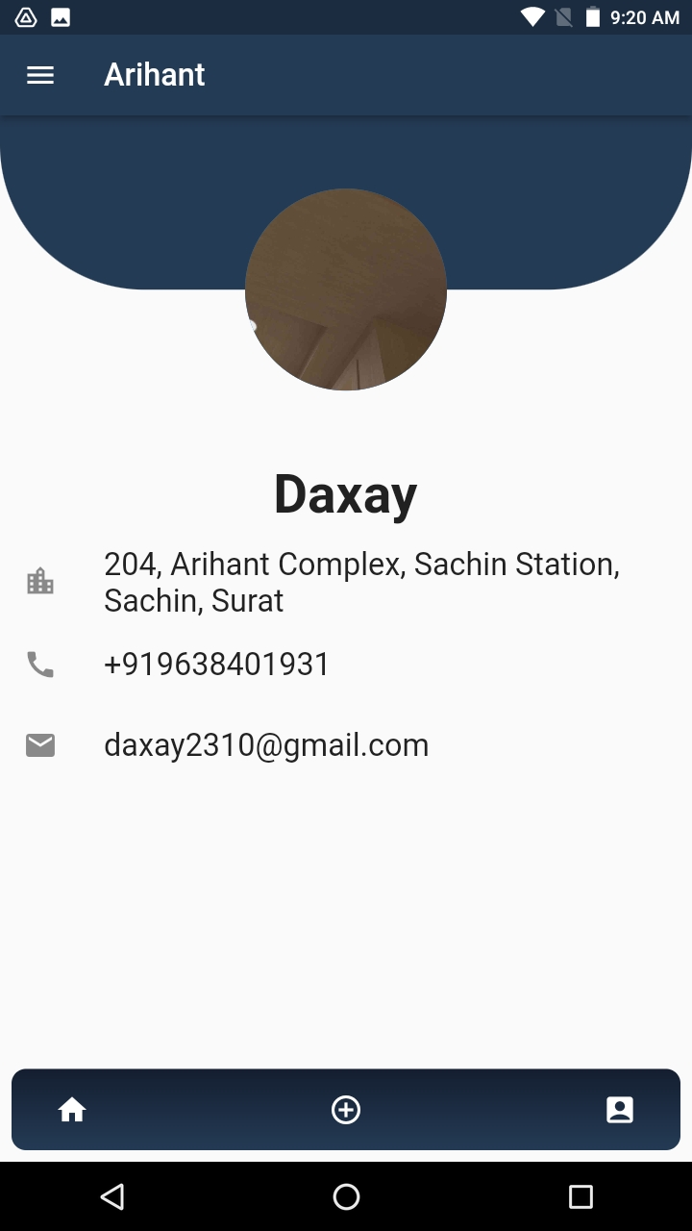
Why we make this Collector application?
This Application will be used by the Collector who is collecting a Amount from Client and Using this Mobile Application They can add the data of collection on day.
Transparency between Admin and Collector

Slide 8
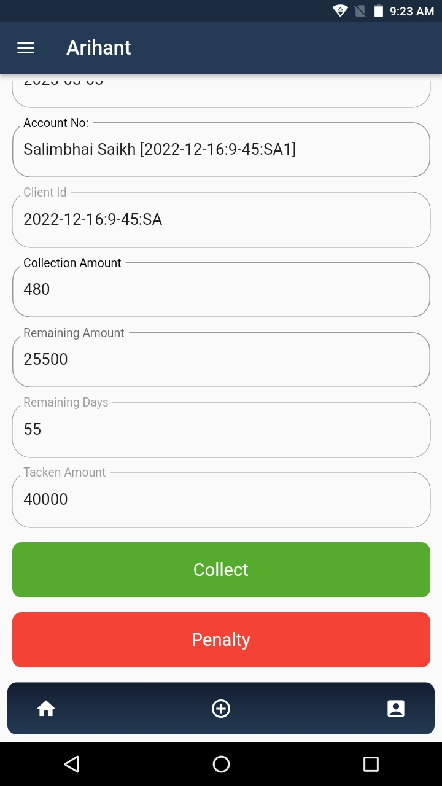
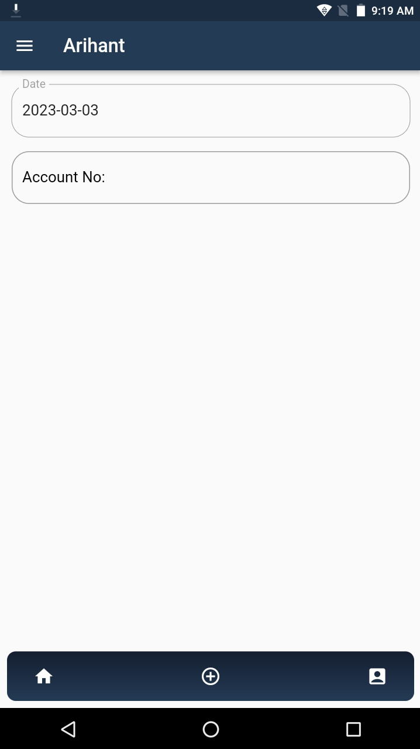
Features of Collector application :
Add collection while Collecting Collection Amount from the Person by Entering an Account Number of Particular Account.
Collector also adds a Penalty if a person denies giving the collection Amount.

Slide 9
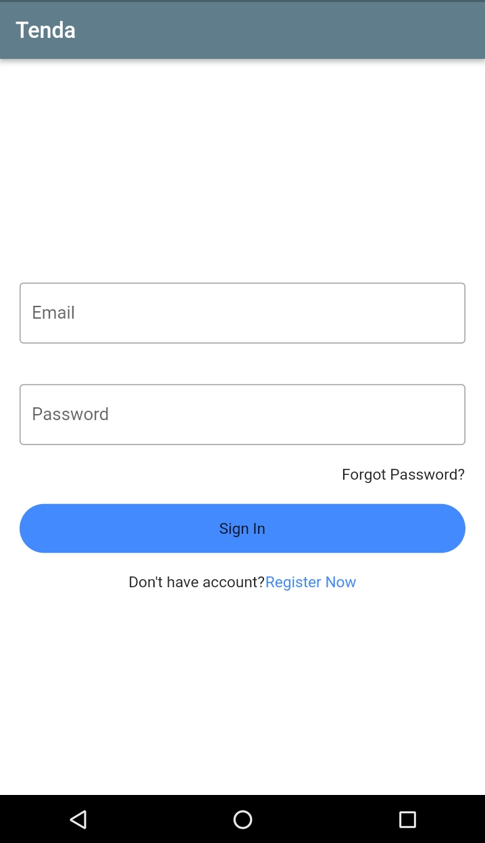
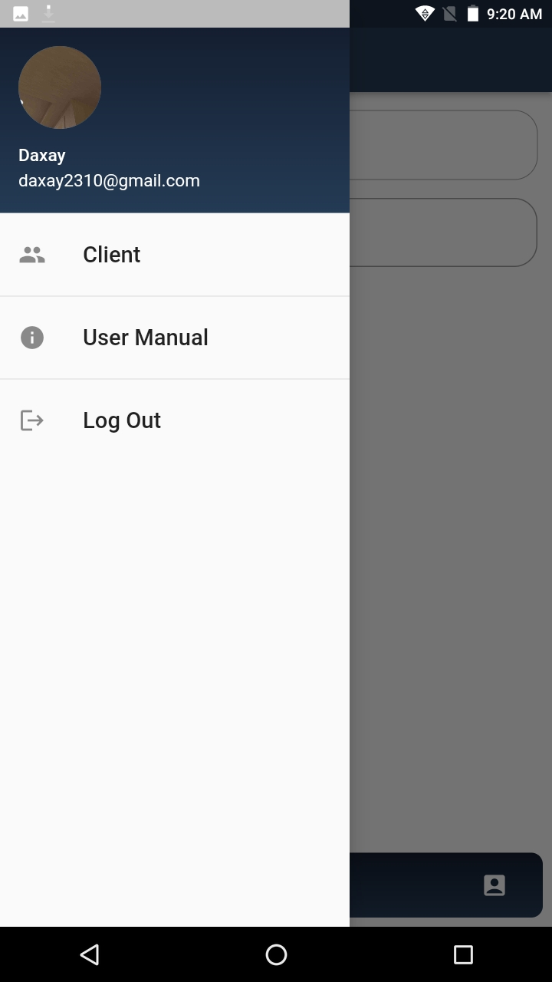
Features of Collector application :
Login
Collector get the Details like Address, Mobile Number of Client.
Also Collector add a New Client or Add Account in existing Client.

Slide 10
Admin(Owner) Mobile Application

Slide 11
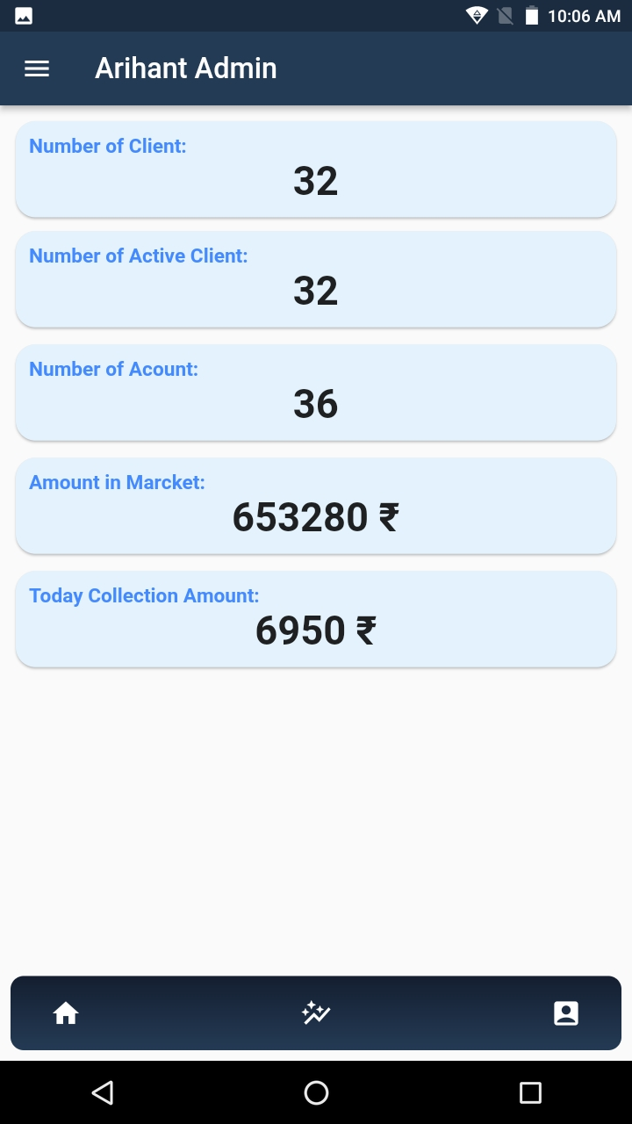
Why we make this Collector application?
This Mobile Application is for the Owner who gets Updates on the Businesses from anywhere at any time.
Manage the Number of Collector associated with Business.

Slide 12
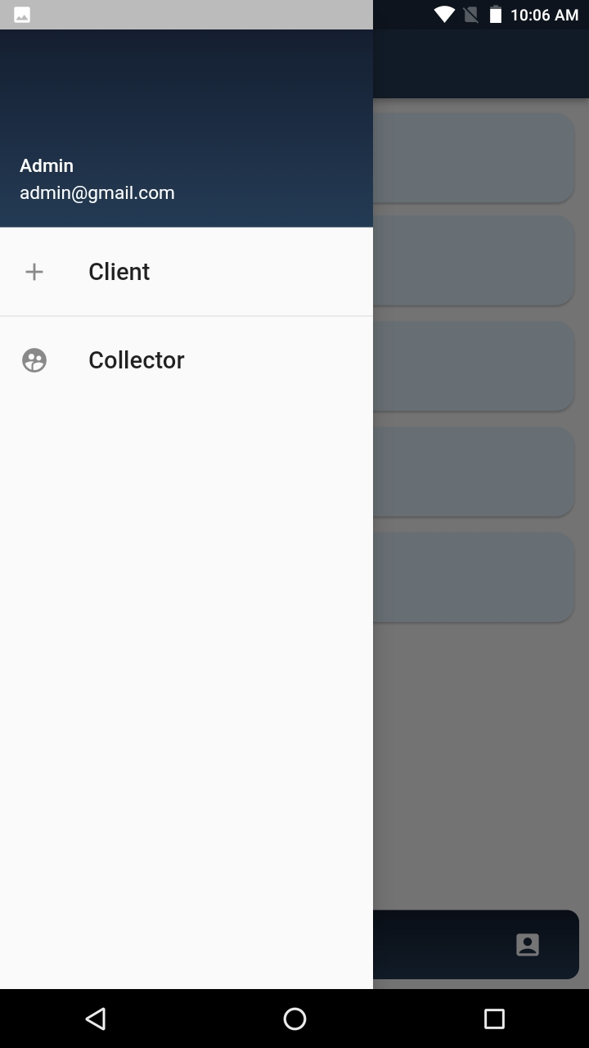
Features of Admin application :
Management of Client as well as Collector Application Credential.
Add new client or Collector and Add new account in existing client.

Slide 13
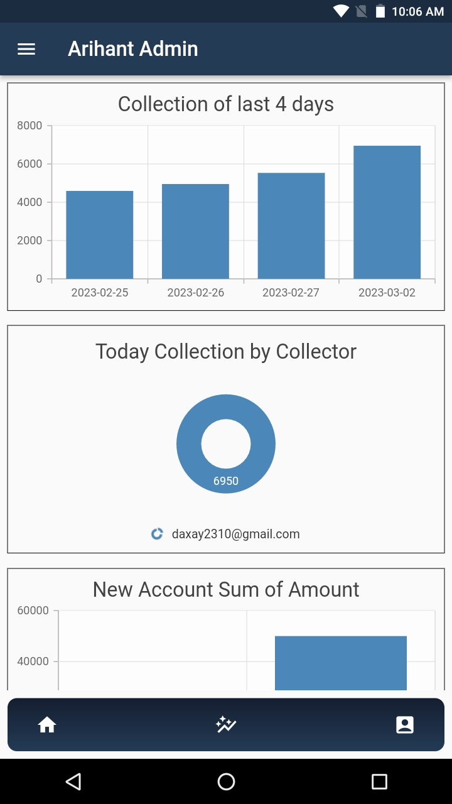
Features of our application :
Data Mining of Collection data using python.
This feature shows the Different chart which will help Owner to take Business decision and get knowledge from the data.

Slide 14

Thank You.....
https://github.com/mr-j-shah/arihant

